Slide 1
Fisheries Management Techniques

Slide 2
What is fisheries management?
Goal is often to produce sustainable biological, environmental and socioeconomic benefits from renewable aquatic resources.
Manage not only fish, but people and habitats.
Research to set regulations and make informed decisions.

Slide 3
Ways we conduct research
Active equipment versus passive equipment
Conduct surveys of not just fish species, creel surveys for angler input
Habitat sampling
eDNA sampling
Notes:
Active is meant to chase and capture target species and passive gears sit in one place allowing the target species in
Boat electrofishing is active gear and hoop nets are passive

Slide 4
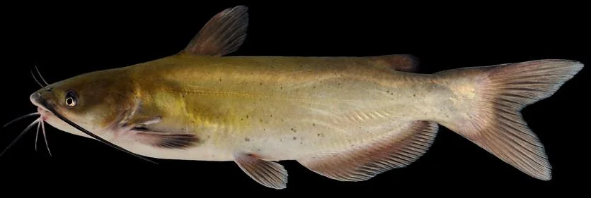
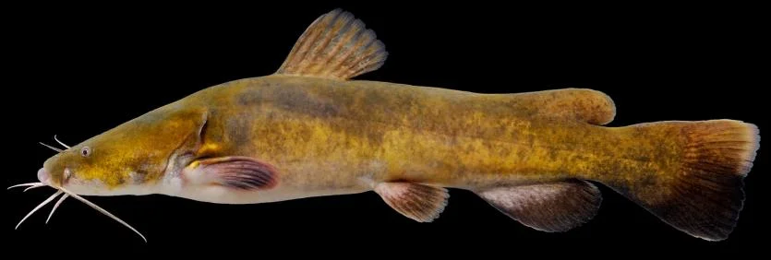
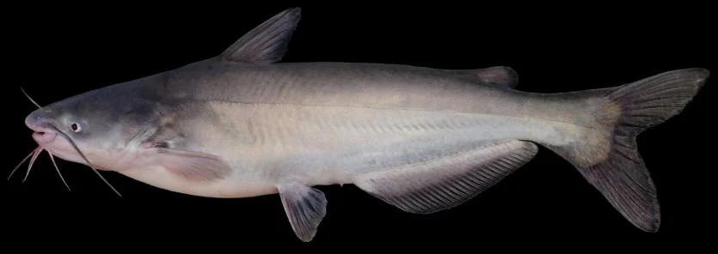
Example family of fish: Ictaluridae
The catfishes
The three main species we manage for are channel, flathead, and blue
Each species is targeted by a different means of equipment

Slide 5
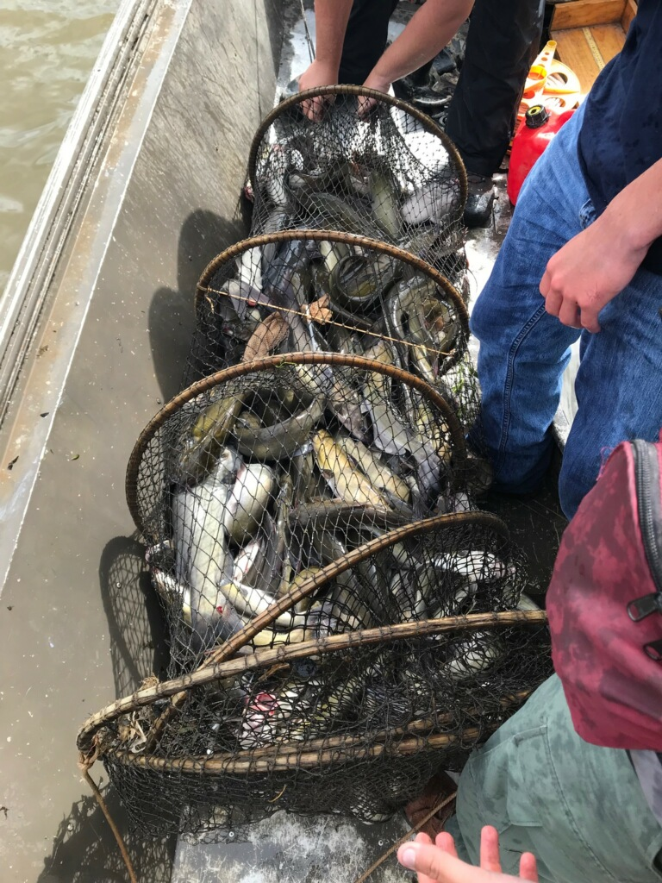
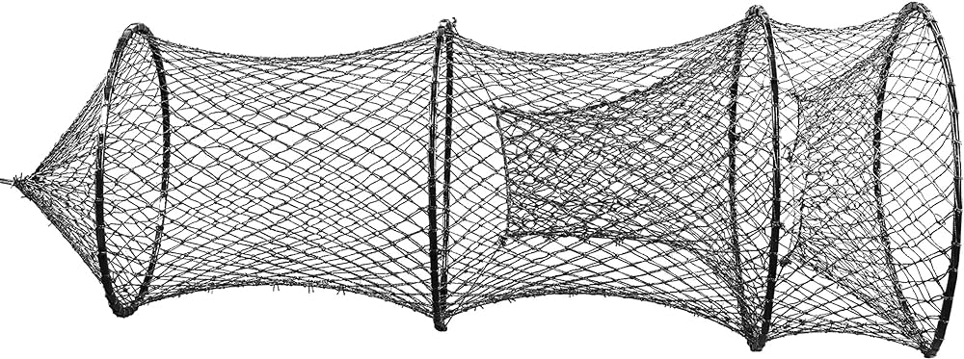
Channel Catfish- Ictalurus punctatus
Sampled for via hoop nets
Passive equipment-set it and come back for it in a few days

Slide 6
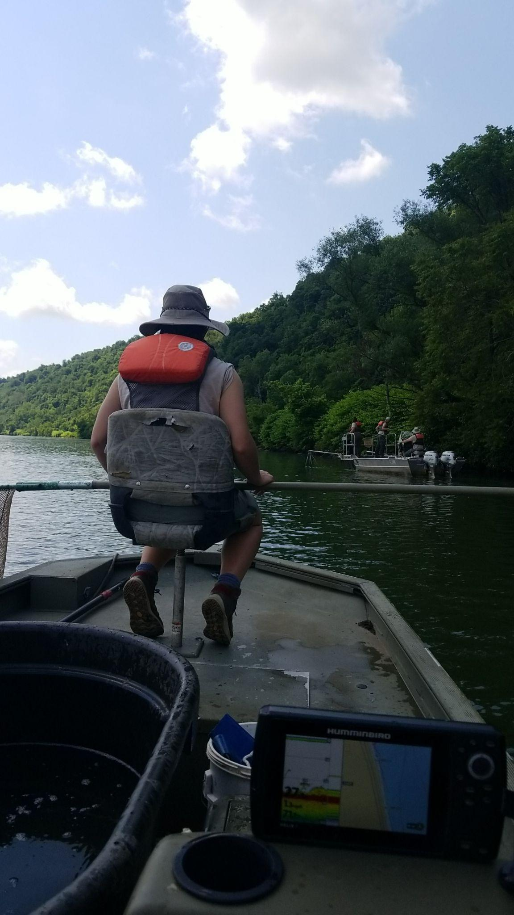
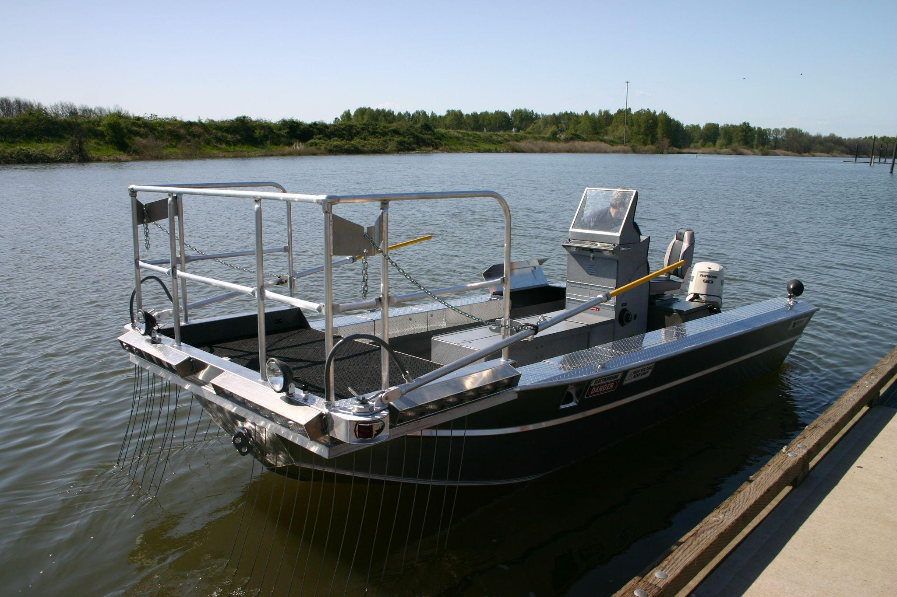
Flathead catfish- Pylodictus olivaris
Low frequency boat electrofishing
Active equipment
Use a shock boat and a secondary boat

Slide 7
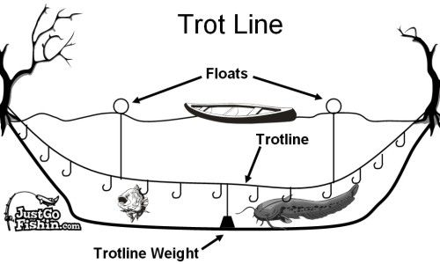
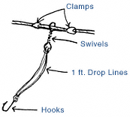
Blue Catfish- Ictalurus furcatus
Trotlines
Passive equipment-set it and come back

Slide 8
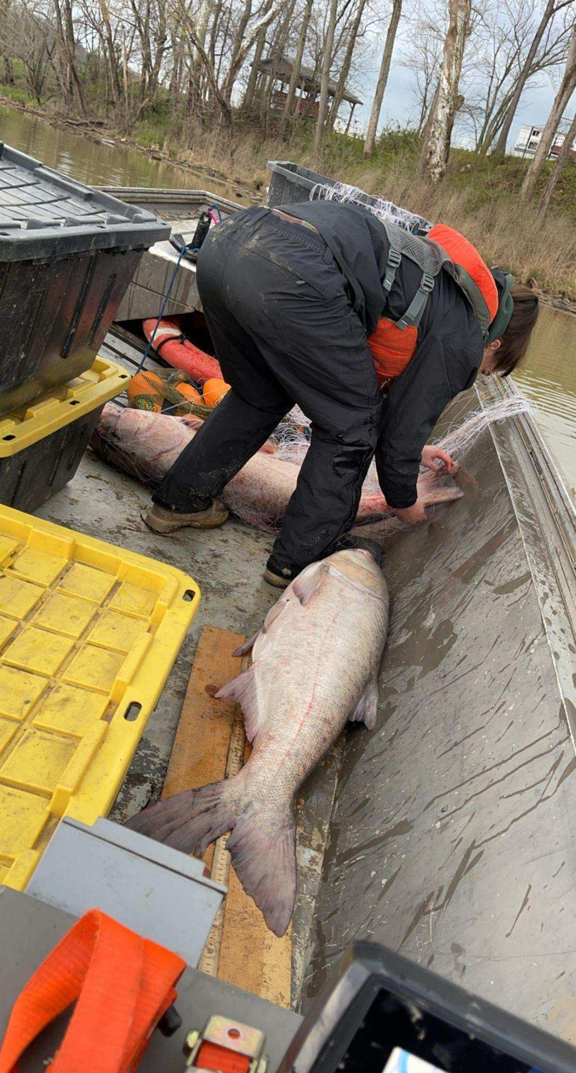
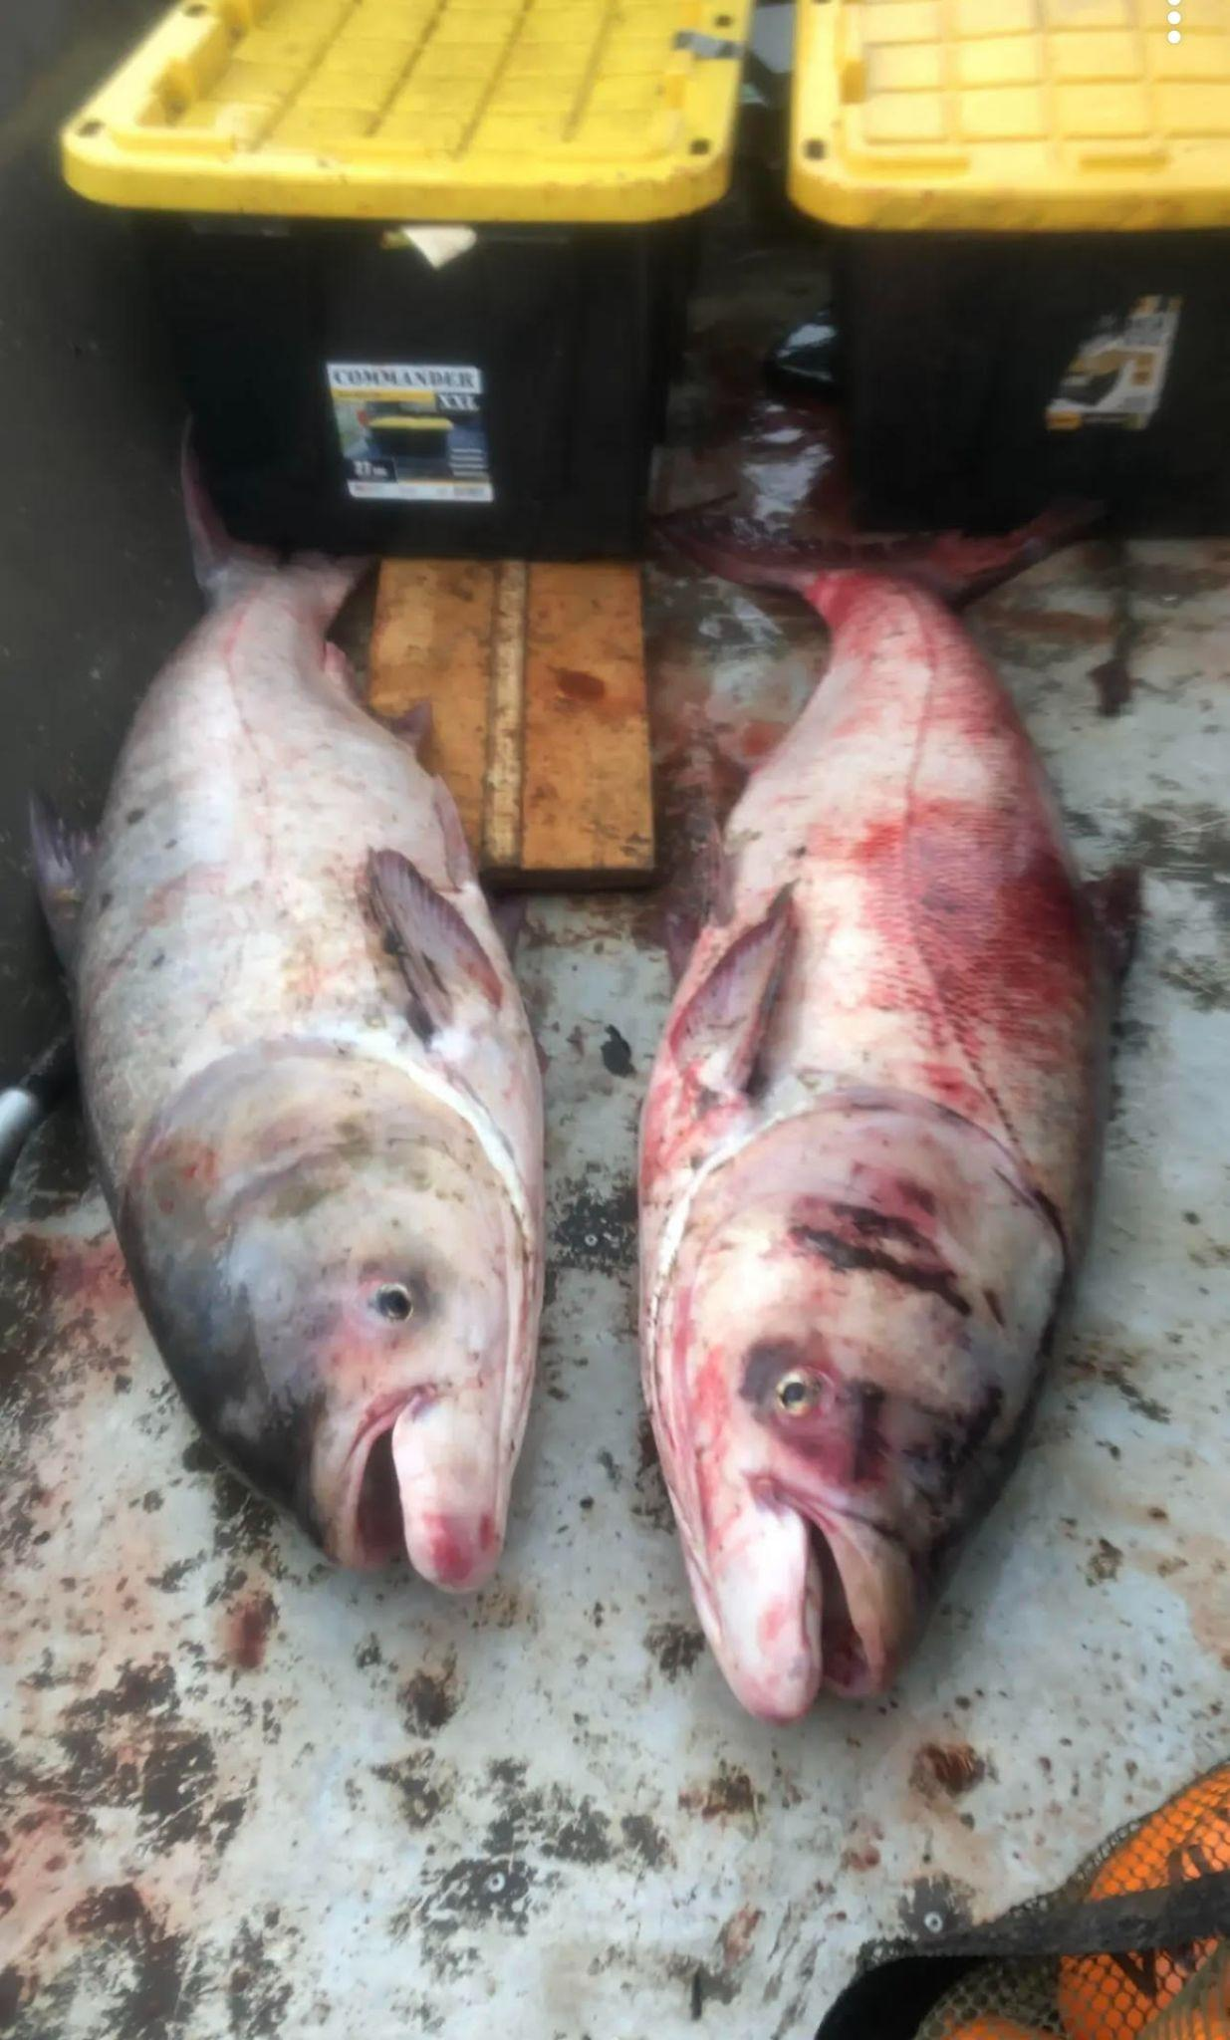
Other techniques:
Gill netting- an inbetween of active and passive. The nets are set for a few hours up to over night. Can even be combined with other techniques such as electrofishing
A ton of other passive net techniques such as fyke nets, trap nets, minnow traps
More active techniques can include larval fish sampling with a tow, young of year (YOY) sampling with a surface trawl, benthic trawls for fish commonly on the bottom (such as sturgeon or black carp)

Slide 9
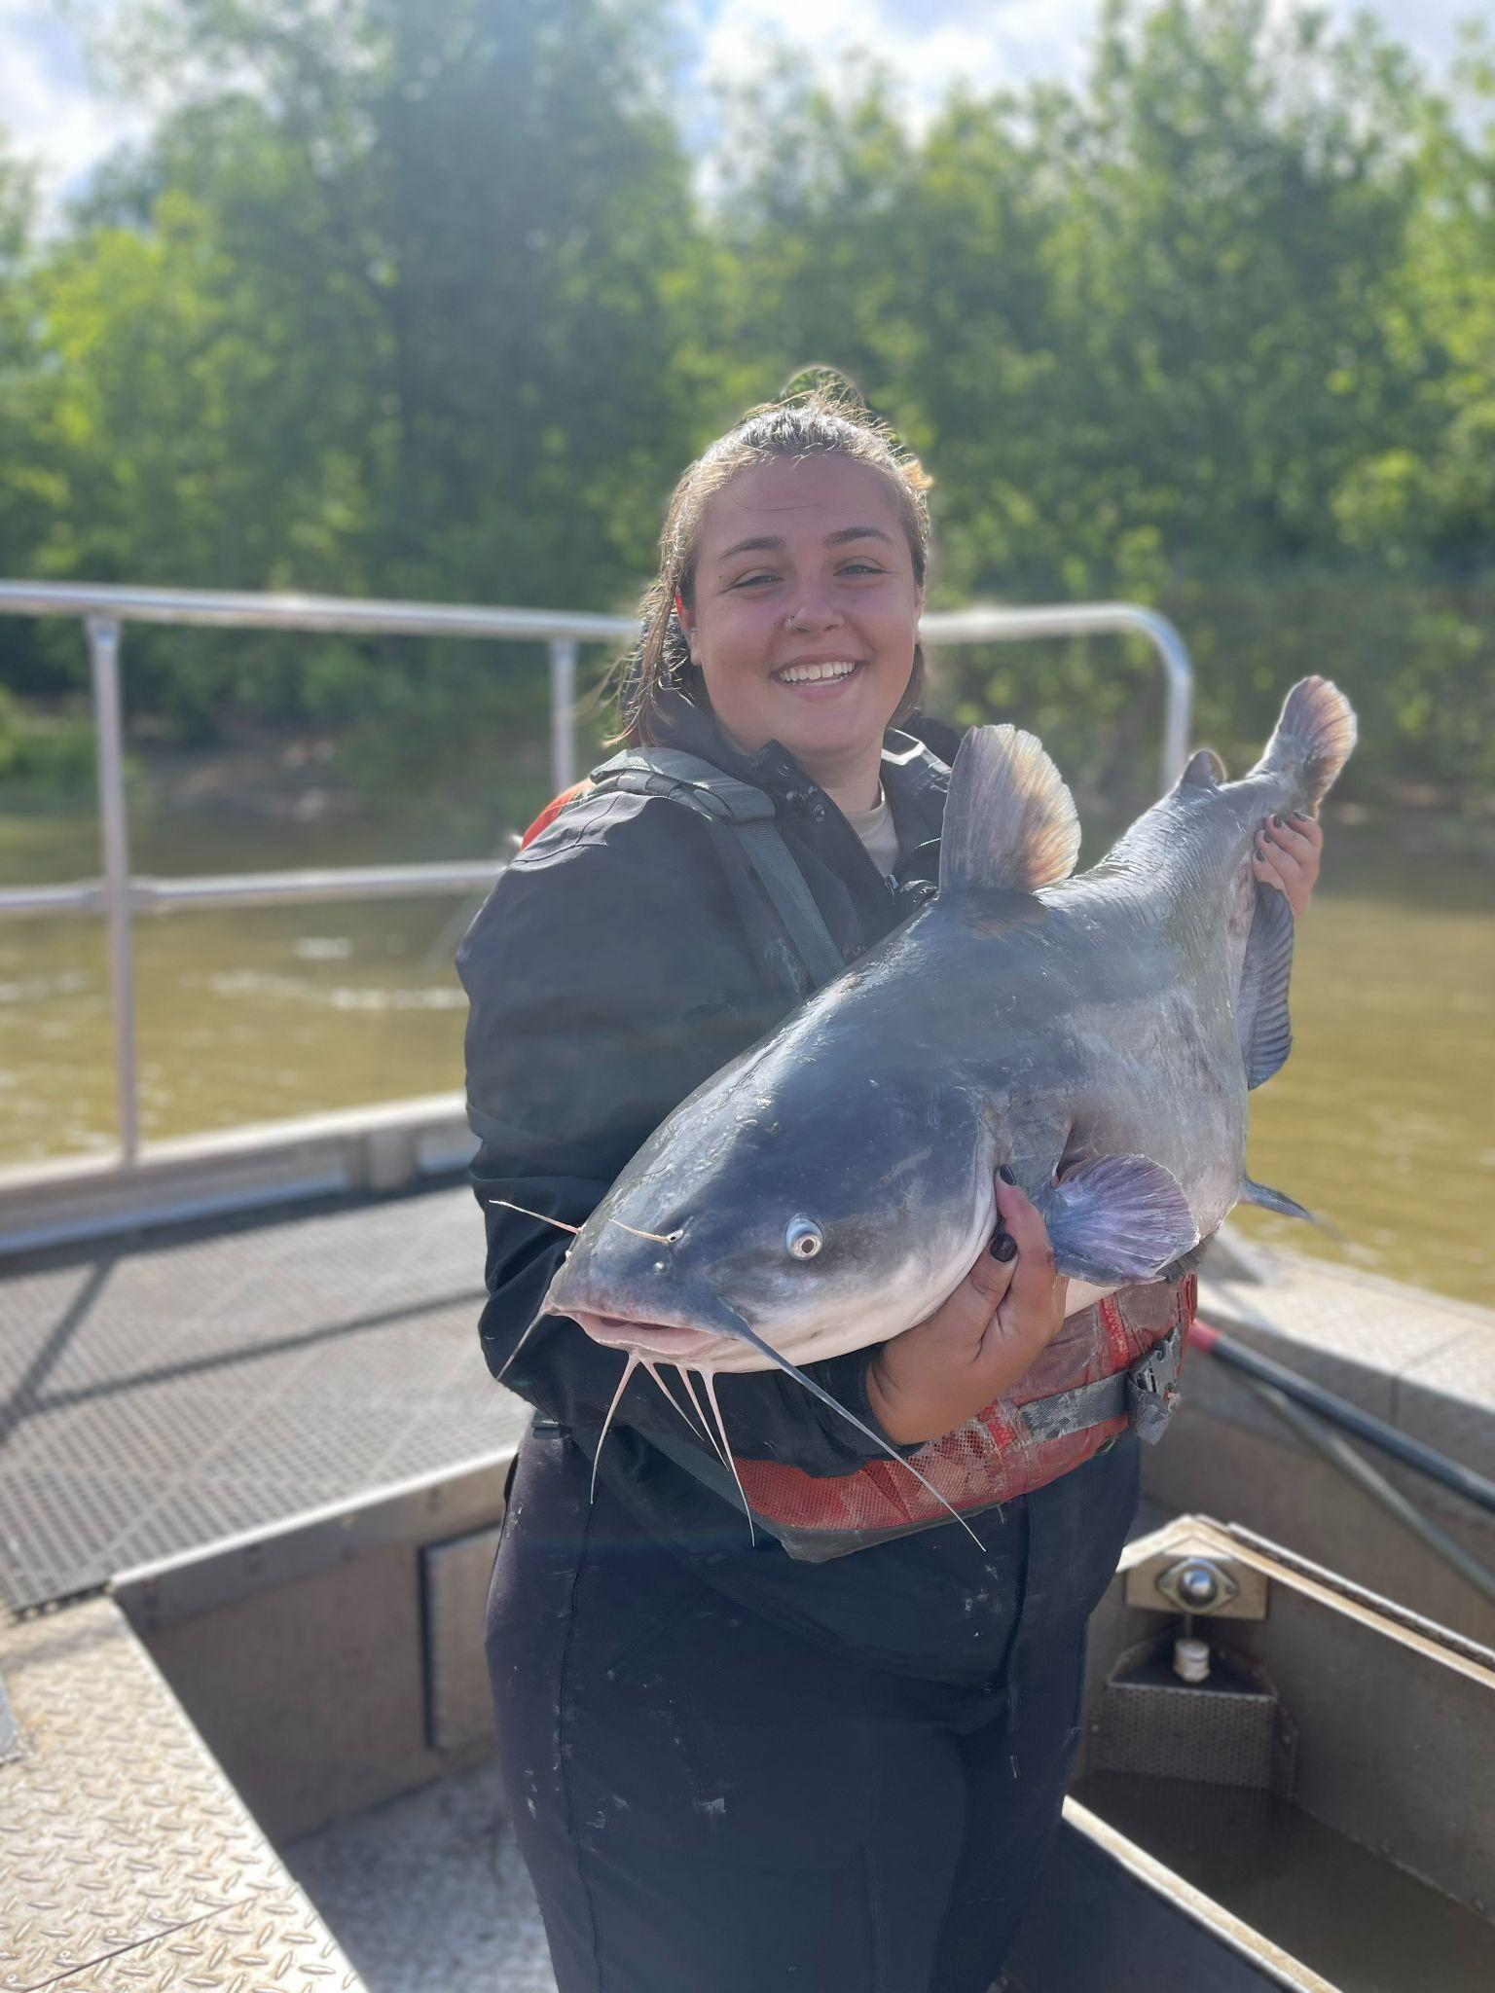
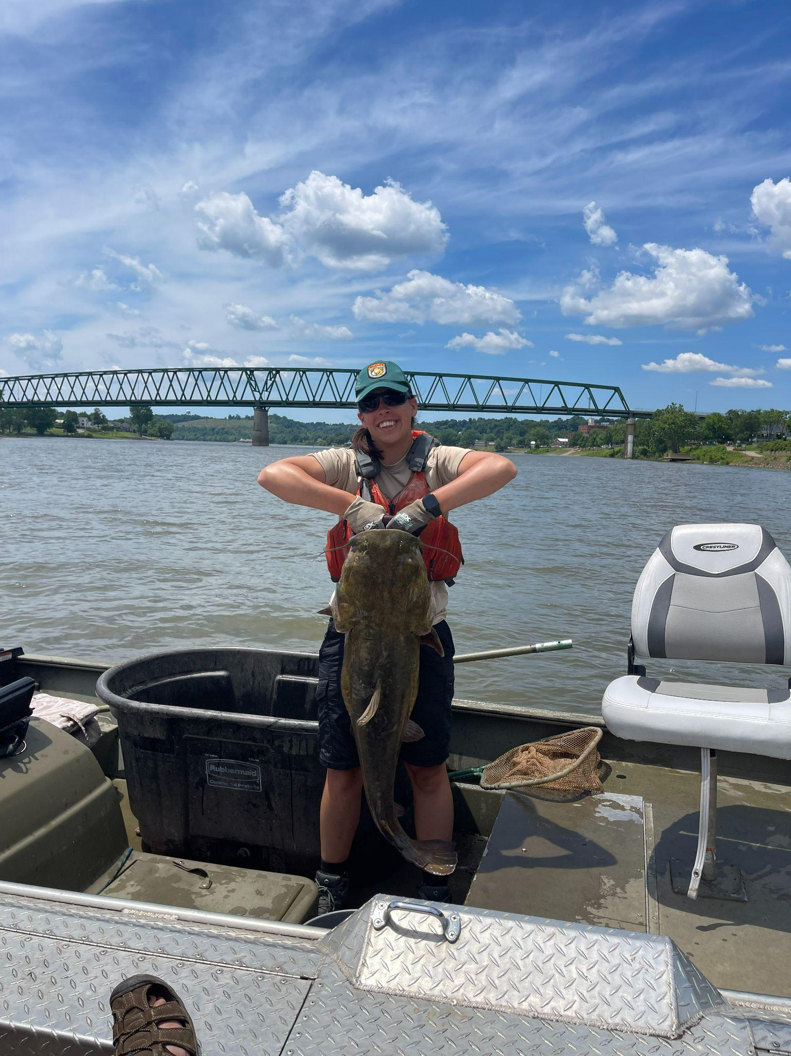
What do we do after sampling?
Depends on the purpose of sampling
Take biological data such as otoliths for aging, length, weight, sex, stomach contents, etc.

Slide 10
What happens with this data?
Regulation suggestions
Length or bag limits placed depending on population structures
Publications from findings
Share the knowledge!

Slide 11
Conclusion
Fisheries Management is often very circumstance specific
Habitat, exploitation, region all have an effect on populations
Up to us to determine problems, research for information, and find solutions

Slide 12
